Slide 1
Chef’s Den
Cooking is therapeutic

Slide 2
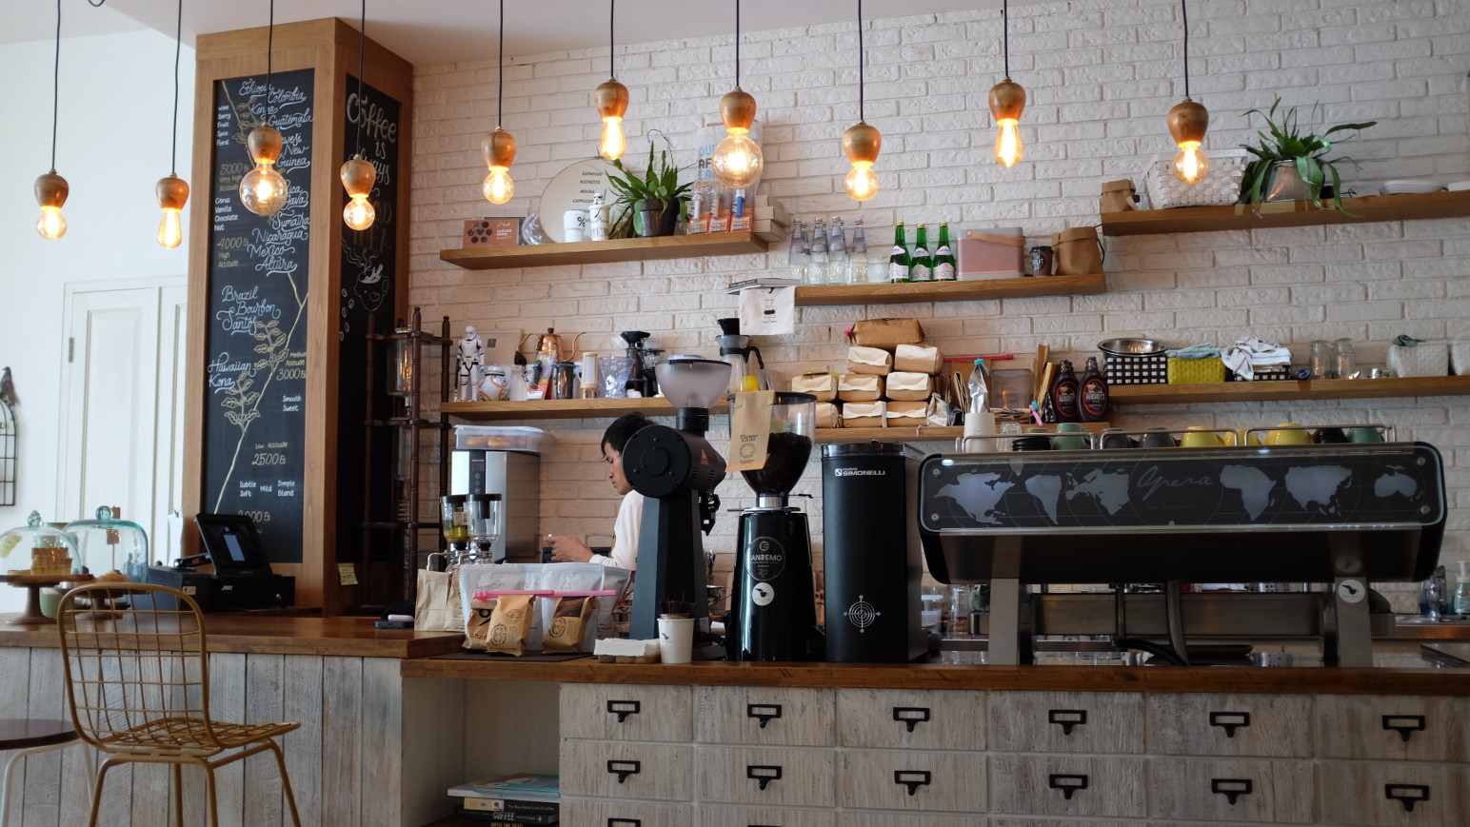
Chef’s den

Slide 3
Chef’s Den - Motivation
We are a bunch of foodies
We are a bunch of ‘last-minute’ people
We are a bunch of lazy people

Slide 4
Chef’s den – contributors
Anthony Hernandez: He is the biggest foodie of all. He came up with the idea for the app. He did the HTML and CSS
Chitra Madhan: She did the Authentication.
Oscar Villalta – The API Guru. And when the beer suggested pairs exactly with the recipe, thank this guy.

Slide 5
Chef’s DEN – Why do you need it?
You have a few ingredients at hand
You want to use what you have
You don’t know what to cook with them
You don’t know the name of that ‘thing’ you had at a restaurant/friend’s place that had exactly the ingredients you have
You are hungry at the wrong time/always

Slide 6
Chef’s Den – how can it help
Search recipes by ingredients
Search recipes by cuisine
Search recipes by type like vegetarian, vegan etc

Slide 7
Chef’s den-how did we build it?
Spoonacular API – the recipes
Punk API – the beer that pairs well with that recipe
Firebase – to manage the recipes you liked
Bootstrap – you know this one

Slide 8
Chef’s den-what next
We are looking in to APIs to integrate a shopping cart for missing ingredients
We are working on adding more log in options
We are keen on adding a feature to enable recipe sharing

Slide 9
Our sincere Thanks to:
Alex Rosenkranz
Tammer Galal
Brian McLendon

